Slide 1



Prediction using Unsupervised Machine Learning
Internship Domain : GRIPMAY2021 - Data Science & Business Analytics Intern
Task Number : #Task2
Task Domain : Machine Learning
PRESENTED BY:
SUSHANTH ARUNACHALAM

Slide 2
PROBLEM
From the given ‘Iris’ dataset, predict the optimum number of clusters and represent it visually
SOLUTION
Use Unsupervised Learning Algorithm
Use K-means Clustering algorithm which uses unlabelled data for training and testing
Find optimum number of clusters
Visualize clusters

Slide 3
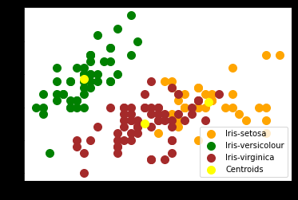
OUTPUT
OUTCOMES from #Task2
Learnt about Unsupervised Machine Learning Algorithms
Learnt K-means Clustering Algorithm
Learnt about creating centroids for each cluster
Learnt about plotting visualizations

Slide 4
THANK YOU

